Slide 1
Streams and Input/Output Files
Part I
Chapter-06
Mohammed Husain Bohara

Slide 2

Streams & Files
The objectives of this chapter are:
To understand the principles of I/O streams and where to use them
To understand the options and limitations of I/O streams
To become comfortable with the mechanisms for accessing the file system

Slide 3
Introduction
So far we have used variables and arrays for storing data inside the programs.
This approach poses the following limitations:

Slide 4
Limitation
The data is lost when variable goes out of scope or when the program terminates. That is data is stored in temporary/mail memory is released when program terminates.
It is difficult to handle large volumes of data.

Slide 5
Solution
We can overcome this problem by storing data on secondary storage devices such as floppy or hard disks.
The data is stored in these devices using the concept of Files and such data is often called persistent data.

Slide 6
File Processing
Storing and manipulating data using files is known as file processing.
Reading/Writing of data in a file can be performed at the level of bytes, characters, or fields depending on application requirements.
Java also provides capabilities to read and write class objects directly. The process of reading and writing objects is called object serialisation.

Slide 7
C Input/Output Revision
FILE* fp;
fp = fopen(“In.file”, “rw”);
fscanf(fp, ……);
frpintf(fp, …..);
fread(………, fp);
fwrite(……….., fp);

Slide 8
Java Application Requirement
abc.txt
FIS
read
Java Application
xyz.txt
FOS
write

Slide 9
Lets write a code
import java.io.*;
class FileIOExample
{
public static void main(String[] args)
{
FileInputStream fis = new FileInputStream("abc.txt");
FileOutputStream fos = new FileOutputStream("xyz.txt");
int c;
while((c=fis.read())!=-1)
{
fos.write(c);
}
fis.close();
fos.close();
}
}

Slide 10
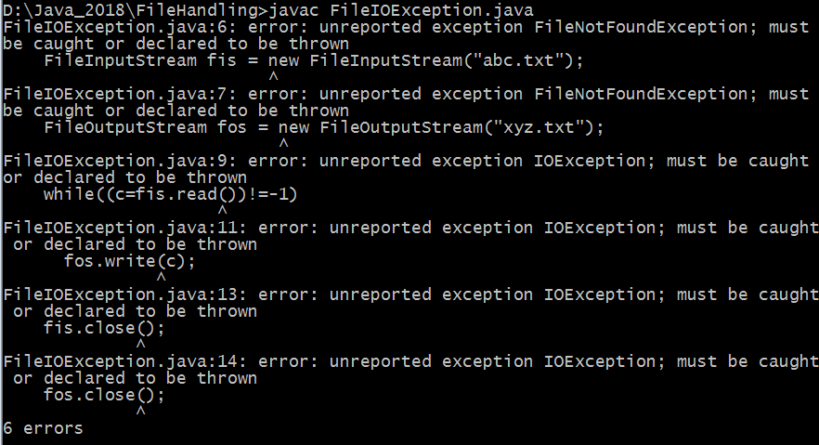
Will it Compile or not

Slide 11
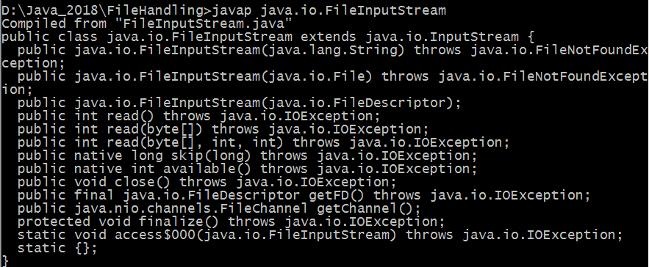
javap java.io.FileInputStream

Slide 12
Handle the exception
import java.io.*;
class FileIOExample
{
public static void main(String[] args) throws FileNotFoundException, IOException
{
FileInputStream fis = new FileInputStream("abc.txt");
FileOutputStream fos = new FileOutputStream("xyz.txt");
int c;
while((c=fis.read())!=-1)
{
fos.write(c);
}
fis.close();
fos.close();
}
}

Slide 13
Output
Make sure that two file must be created
Data will be copied successfully

Slide 14
What will be the output here?
import java.io.*;
class FileIOExample
{
public static void main(String[] args) throws FileNotFoundException, IOException
{
FileInputStream fis = new FileInputStream("abc.txt");
FileOutputStream fos = new FileOutputStream("xyz.txt");
int c;
while((c=fis.read())!=-1)
{
System.out.println(c);
fos.write(c);
}
fis.close();
fos.close();
}
}

Slide 15
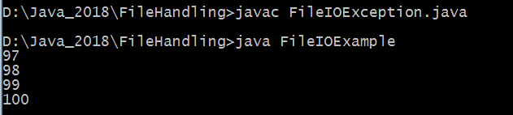
Output

Slide 16
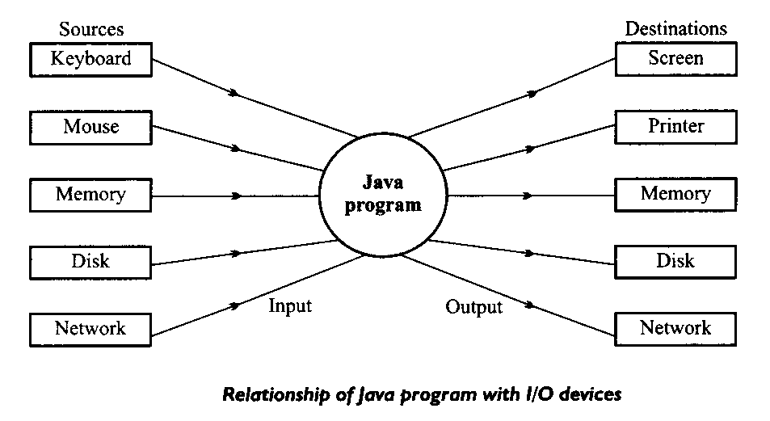
I/O and Data Movement
The flow of data into a program (input) may come from different devices such as keyboard, mouse, memory, disk, network, or another program.
The flow of data out of a program (output) may go to the screen, printer, memory, disk, network, another program.
Both input and output share a certain common property such as unidirectional movement of data – a sequence of bytes and characters and support to the sequential access to the data.

Slide 17
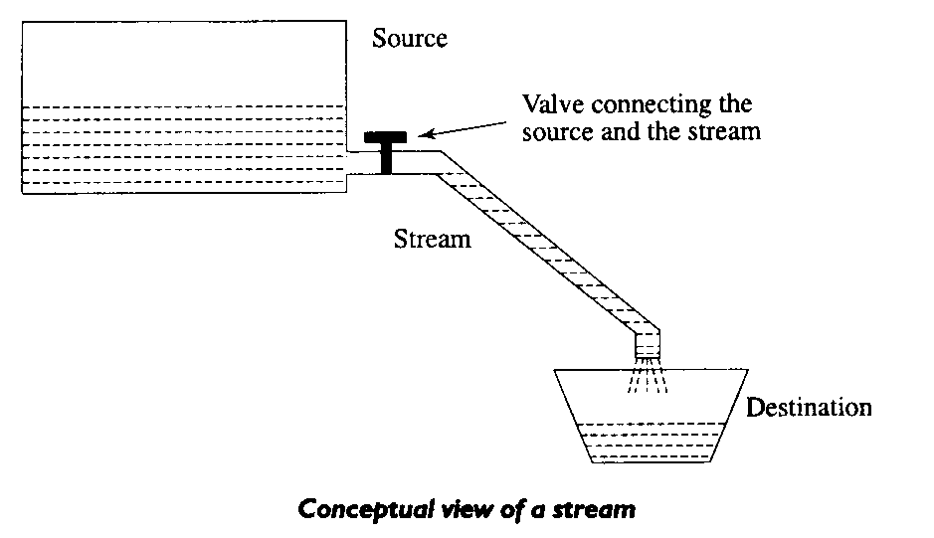
Streams
Java Uses the concept of Streams to represent the ordered sequence of data, a common characteristic shared by all I/O devices.
Streams presents a uniform, easy to use, object oriented interface between the program and I/O devices.
A stream in Java is a path along which data flows (like a river or pipe along which water flows).

Slide 18
Stream Types
The concepts of sending data from one stream to another (like a pipe feeding into another pipe) has made streams powerful tool for file processing.
Connecting streams can also act as filters.
Streams are classified into two basic types:
  Input Steam
  Output Stream
Input Stream
reads
Source
Program
Output Stream
Program
Source
writes

Slide 19
Java Stream Classes
Input/Output related classes are defined in java.io package.
Input/Output in Java is defined in terms of streams.
A stream is a sequence of data, of no particular length.
Java classes can be categorised into two groups based on the data type one which they operate:
  Byte streams
  Character Streams

Slide 20
Streams
Byte Streams | Character streams
Operated on 8 bit (1 byte) data. | Operates on 16-bit (2 byte) unicode characters.
Input streams/Output streams | Readers/ Writers

Slide 21
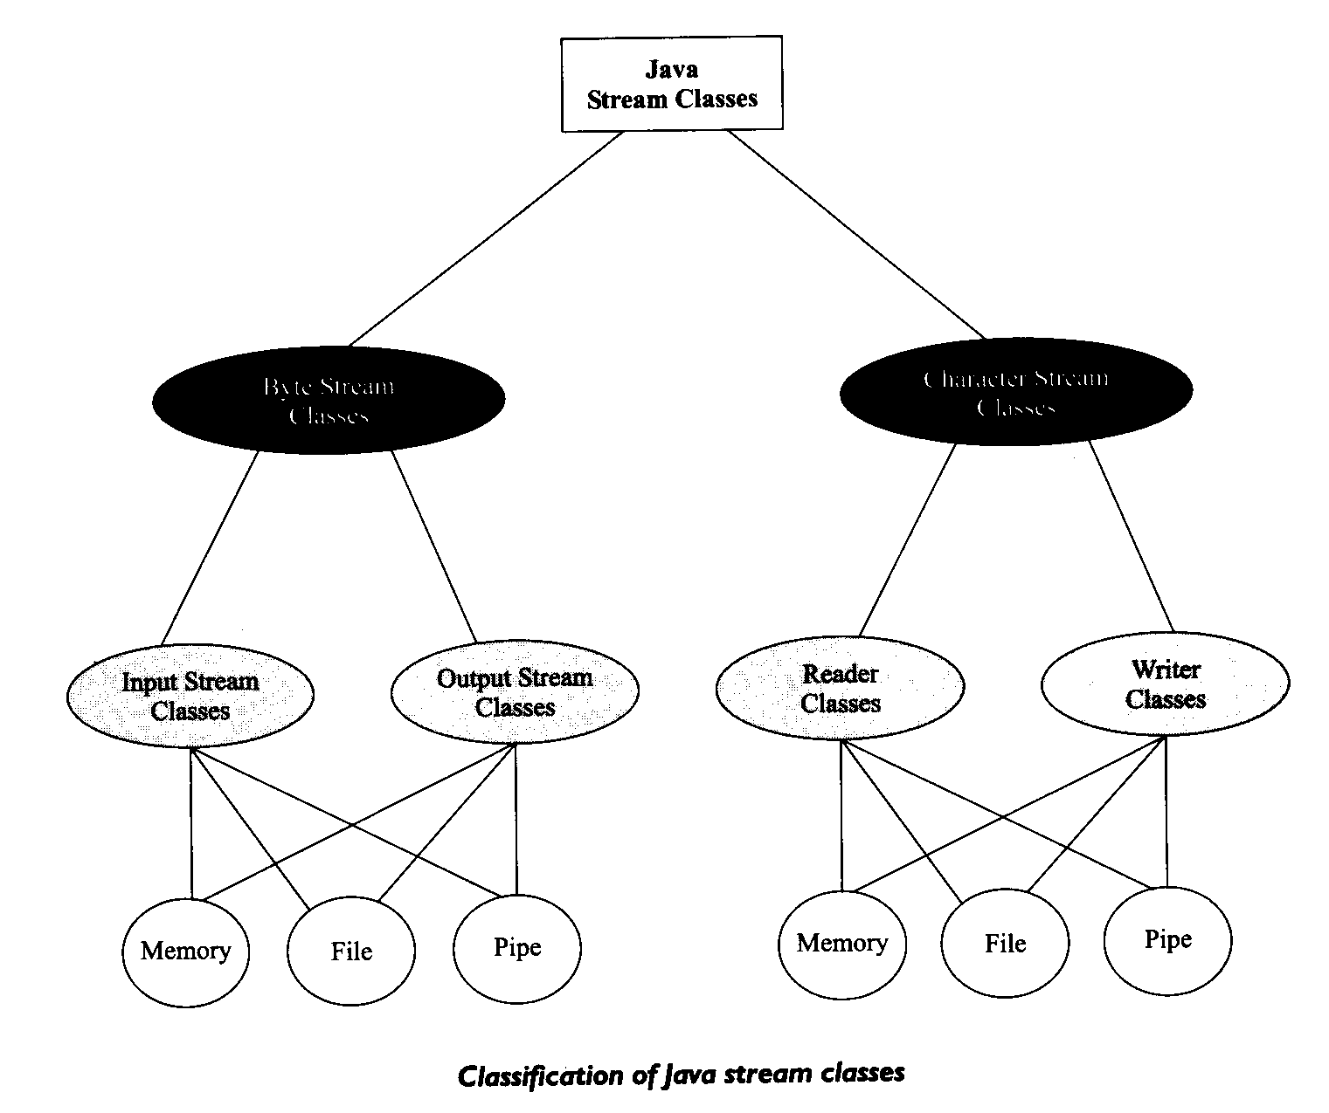
Byte Stream
classes
Character Stream
classes

Slide 22
Byte Input Streams
InputStream
FileInputStream
ObjectInputStream
SequenceInputStream
ByteArrayInputStream
PipedInputStream
FilterInputStream
PushbackInputStream
BufferedInputStream
DataInputStream

Slide 23
Java I/O – Using InputStreams
Basic pattern for I/O programming is as follows:
Open a stream
While there’s data to read
Process the data
Close the stream

Slide 24
Java I/O – Using InputStreams
InputStream in = new FileInputStream(“c:\\temp\\myfile.txt”);
int b = in.read();
while (b != -1)
{
b = in.read();
}
in.close();

Slide 25
Java I/O – Using InputStreams
But using buffering is more efficient, therefore we always nest our streams…
InputStream inner = new FileInputStream(“c:\temp\myfile.txt”);
InputStream in = new BufferedInputStream(inner);
int b = in.read();
while (b != -1)
{
b = in.read();
}
in.close();

Slide 26
Byte Input Streams - operations
public abstract int read() | Reads a byte and returns as a integer 0-255
public int read(byte[] buf, int offset, int count) | Reads and stores the bytes in buf starting at offset. Count is the maximum read.
public int read(byte[] buf) | Same as previous offset=0 and length=buf.length()
public long skip(long count) | Skips count bytes.
public int available() | Returns the number of bytes that can be read.
public void close() | Closes stream

Slide 27
Byte Input Stream – example-2
Count total number of bytes in the file
import java.io.*;
class CountBytes {
public static void main(String[] args)
throws FileNotFoundException, IOException
{
FileInputStream in;
in = new FileInputStream(“InFile.txt”);
int total = 0;
while (in.read() != -1)
total++;
System.out.println(total + “ bytes”);
}
}

Slide 28
What happens if the file did not exist
JVM throws exception and terminates the program since there is no exception handler defined.
Exception in thread "main" java.io.FileNotFoundException: FileIn.txt (No such file or directory)
at java.io.FileInputStream.open(Native Method)
at java.io.FileInputStream.<init>(FileInputStream.java:64)
at CountBytes.main(CountBytes.java:12)

Slide 29
Example 3 - Copy Function
import java.io.*;
public class CopyFile
{
public void copyFile(String inputFilename, String outputFilename)
{ try
{ FileInputStream fpin = new FileInputStream(inputFilename);
FileOutputStream fpout = new FileOutputStream(outputfilename);
byte buffer = new byte[8192];
int length = 0;
while ((length = fpin.read(buffer, 0, buffer.length)) > 0)
{
fpout.write(buffer, 0, length);
}
fpout.flush();
fpout.close();
fpin.close();
}
catch (IOException x)
{ System.out.println("Error:" + x);
}}}

Slide 30
Byte Output Streams
FileOutputStream
OutputStream
ObjectOutputStream
SequenceOutputStream
ByteArrayOutputStream
PipedOutputStream
FilterOutputStream
PrintStream
BufferedOutputStream
DataOutputStream

Slide 31
Byte Output Streams - operations
public abstract void write(int b) | Write b as bytes.
public void write(byte[] buf, int offset, int count) | Write count bytes starting from offset in buf.
public void write(byte[] buf) | Same as previous offset=0 and count = buf.length()
public void flush() | Flushes the stream.
public void close() | Closes stream

Slide 32
Byte Output Stream - example
Read from standard in and write to standard out
import java.io.*;
class ReadWrite {
public static void main(String[] args)
throws IOException
{
int b;
while (( b = System.in.read()) != -1)
{
System.out.write(b);
}
}}

Slide 33
Summary
Streams provide uniform interface for managing I/O operations in Java irrespective of device types.
Java supports classes for handling Input Steams and Output steams via java.io package.
Exceptions supports handling of errors and their propagation during file operations.

